Slide 1
Name -Mahbub Hasan Prantik
ID - 1612751042
Group - 5
Email - hasan.prantik@northsouth.edu

Slide 2
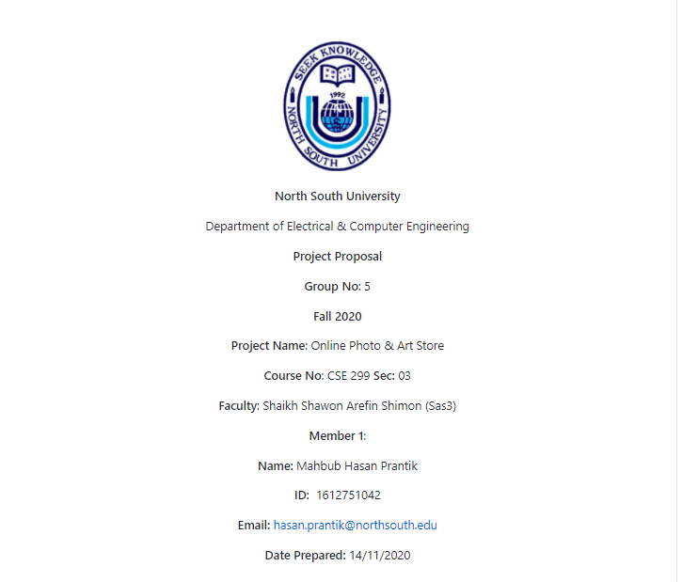
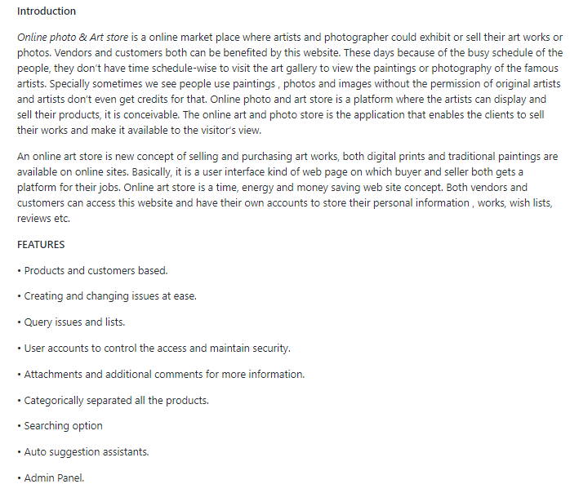
Project RPROJECT READMEeadme

Slide 3
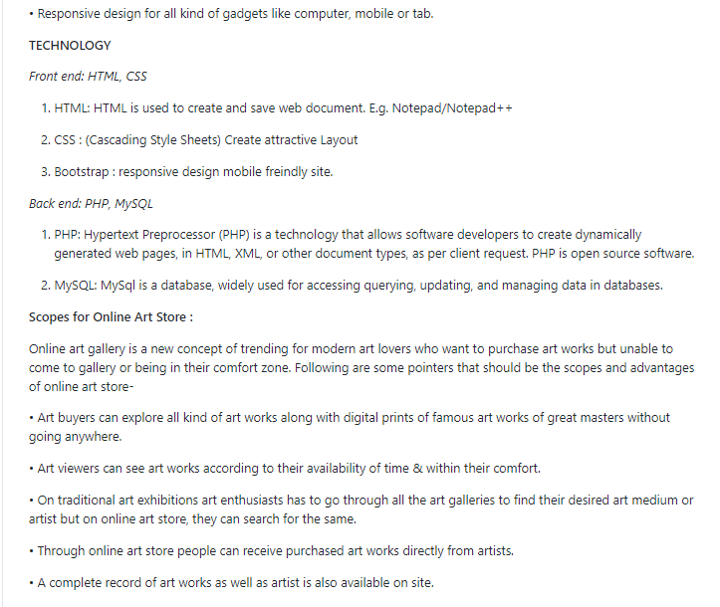
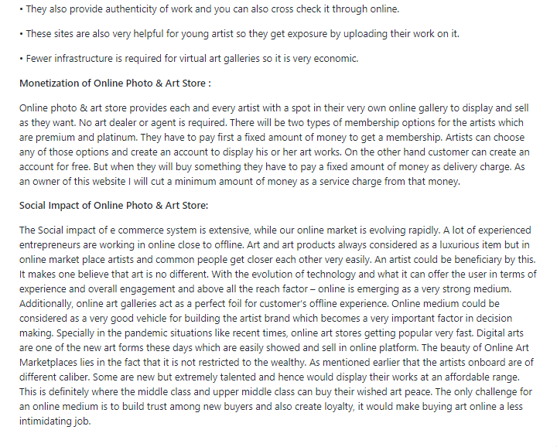
PROJECT README

Slide 4
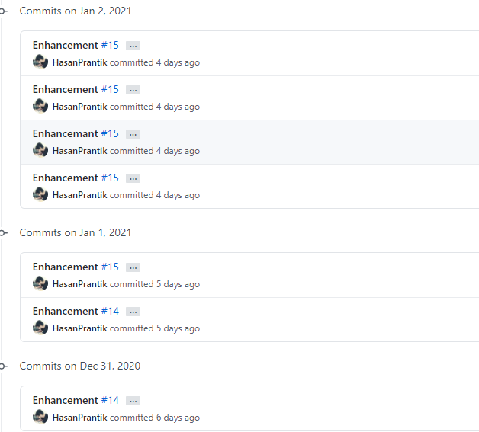
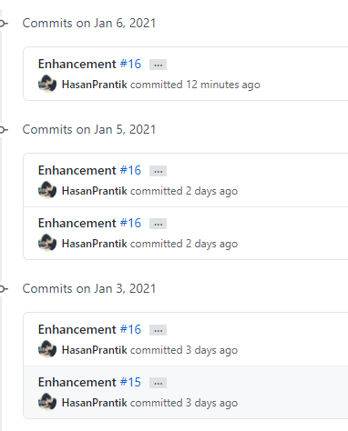
Commits in Week 10

Slide 5
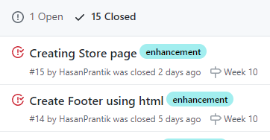
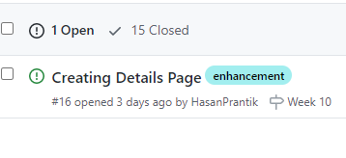
Issues In Week 09
Issues In Week 10

